Slide 1
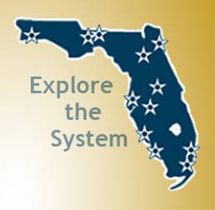
Tools of the Trade
Isis Carbajal de Garcia
Attorney-at-Law

Slide 2
I THE LAWS THAT GOVERN US
1. The US Constitution
2. Federal Laws and Regulations
3. State of Florida Laws

Slide 3
II THE GOVERNING RULES UNDER WHICH WE OPERATE – FIND THE RULES AND FOLLOW THEM
1. Florida Board of Governors Regulations
http://www.flbog.edu/about/regulations/regulations.php
2. University Regulations
- FAMU http://www.famu.edu/index.cfm?a=regulations
- FAU http://www.fau.edu/regulations/
- FGCU http://www2.fgcu.edu/generalcounsel/regulations.asp#skipnav
- FIU http://www.fiu.edu/trustees/
- FPU http://floridapoly.edu/about/board-of-trustees/university-policies-regulations- rules/
- FSU http://regulations.fsu.edu/
- NCF https://www.ncf.edu/about/departments-and-offices/office-of-the-general counsel/regulations/
- UCF http://regulations.ucf.edu/index.html
- UF http://regulations.ufl.edu/
- UNF http://www.unf.edu/president/policies_regulations/
- USF http://www.flbog.edu/universities/usf.php
- UWF http://uwf.edu/offices/board-of-trustees/

Slide 4
III THE GOVERNING RULES UNDER WHICH WE OPERATE – FIND THE RULES AND FOLLOW THEM
3. Collective Bargaining Agreements –
Examples of agreements with the United Faculty of Florida (UFF)
- http://hr.fsu.edu/pdf/2015-2018FSU-BOT_GAU_CBA.pdf
- http://www.uff-uf.org/wp-content/uploads/2012/09/2017-19-Collective-Bargaining-Agreement.pdf
- http://unf-uff.org/faculty-contract/
- https://uwf.edu/offices/academic-affairs-division/resources/collective-bargaining/
- http://www.fau.edu/provost/faculty/files/CBA-2015-2018_Ratified_6-7-16.pdf
- http://www.usf.edu/hr/documents/employment-resources/employee-labor-relations/uff-collective-bargaining-agreement.pdf
- http://www.collectivebargaining.ucf.edu/proposals/2015-2018FB/2015-11-12AllTAdArticlesBOOK.pdf
- https://drive.google.com/file/d/0BwBq4-M6Y-8mUVNqWDRMWXp2UnJwX2pUSUxLRElFQ3NnSlZN/view
- http://www.unitedfacultyofflorida.org/governance/

Slide 5
IV THE GOVERNING RULES UNDER WHICH WE OPERATE- FIND THE RULES AND FOLLOW THEM
4. Faculty Handbook –
● Examples:
http://academic.fiu.edu/docs/faculty_handbook.pdf
http://handbook.aa.ufl.edu/teaching/policies/
http://www.unf.edu/acadaffairs/Faculty_Handbook.aspx
https://facultyhandbook.fsu.edu/
5. University – Policies & Procedures –
● Examples:
http://policies.fiu.edu/
https://floridapoly.edu/about/board-of-trustees/university-policies-regulations-rules/
http://aa.ufl.edu/policies/
http://policies.ucf.edu/

Slide 6
V SELECTIVE LAWS OF INTEREST
A. INDEMNIFICATION
1. Florida law protects public employees when they act in a negligent manner within the scope and course of their employment (provided they do not act on bad faith or with malicious purpose or in a manner exhibiting wanton and willful disregard of human rights, safety, or property (Section 768.28 of the Florida Statutes).
2. The University will defend its employees in civil actions arising from their acts as described in A above (Section 1004.25 of the Florida Statutes),
3. The Florida International University Board of Trustees Operating Procedures provides for the indemnification of Florida International University officers and employees (Article VII, FIU/BOT Operating Procedures),

Slide 7
VI SELECTIVE LAWS OF INTEREST
B. SUNSHINE LAW – Public Records and Public Meetings
1. Public Records
● Records Retention Schedules
http://dos.myflorida.com/library-archives/records-management/general-records-schedules/
● FAQ from the Records Management website
http://dos.myflorida.com/library-archives/records-management/records-management-faq/

Slide 8
VII SELECTIVE LAWS OF INTEREST
2. Public Meetings – Section 286.011, Florida Statutes Section 286.011 (1) provides as follows:
286.011 Public meetings and records; public inspection; criminal and civil penalties. – (1) All meetings of any board or commission of any state agency or authority or of any agency or authority of any county, municipal corporation, or political subdivision, except as otherwise provided in the Constitution, including meetings with or attended by any officials acts are to be taken are declared to be public meetings open to the public at all times, and no resolution, rule, or formal action shall be considered binding except as taken or made at such meeting. The board or commission must provide reasonable notice of all such meetings.

Slide 9
VIII SELECTIVE LAWS OF INTERESTS
C. ANTI-DISCRIMINATION LAWS – race, color, national origin, age, disability, sex (including sexual harassment and Title IX issues), marital status, veteran status, and religion. _ Board of Governor Regulation 2.003
http://www.flbog.edu/documents_regulations/regulations/2_003final.pdf

Slide 10
IX SELECTIVE LAWS OF INTEREST
D. FIRST AMMENDMENT RIGHTS AND ACADEMIC FREEDOM
First Amendment Rights Differ from Academic Freedom
• Under the First Amendment of the U.S. Constitution the government “may not abridge the right of speech.”
• Academic Freedom is a tradition in academe recognized by the American Association of University Professors and applicable to both state and private educational institutions. It is not based on law, but courts have recognized it as an academic principle.
• For public institutions, the ability to restrict the speech of its employees is limited by a test the U.S. Supreme Court originally outlined in 1968 that requires a determination of whether the employee speaks on a matter of public concern.

Slide 11
First Amendment Analysis for Public Academic Institutions:
• What constitutes a matter of public concern? Any speech that relates to any matter of political, social, or other concern to the community falls under this category.
• What kind of speech does not address a matter of public concern? When a public employee’s speech is purely job-related or made pursuant to his/her official duties, the employee’s speech will not be deemed a matter of public concern.
• Is speech related to scholarship or teaching part of the faculty member’s professional responsibilities and thus not protected under the rubric of “public concern”?
o Examples of employee’s speech made pursuant to duties.
o Examples of employee’s speech not made pursuant to duties.

Slide 12
Are Facebook and other social media postings protected by the First Amendment?
To determine whether an employee’s speech is a matter of public concern, the courts consider the content, form, and context of the speech.
Courts have begun to develop rules to guide employers and employees debating the level of protection afforded to employee comments made on social media like Facebook, Twitter, etc.
An individual’s First Amendment interest in posting on Facebook is reduced when he or she configures such posts to be private.

Slide 13
How are the rights of public employers and employees balanced?
The analysis the courts undertake involves a balancing test between the freedom of speech of the employee and the interest of the employer to an efficient and effective working operation.
This balancing test reflects the latitude that must be given to government employers to manage their offices - without intrusion by the courts in the name of the First Amendment - and to take action against employees who engage in speech that ‘may unreasonably disrupt the conduct of government operations.
The focus of this test is at the “manner, time, and place” of the challenged speech and “the context” in which it arose.

Slide 14
Who has the ultimate burden of showing that the negative employment action was motivated by the employee’s speech?
If the employee is found to have spoken on a matter of public concern and his/her interests outweigh that of the employer, the employee must still show that the speech played a substantial part in the adverse employment action.
If the employer can show by a preponderance of evidence that it would have made the same decision even in the absence of the protected speech, the employer prevails.,

Slide 15
What are relevant factors considered in determining motivation?
• Whether adverse action closely followed the protected speech.
• Whether the employee showed that other explanations for the adverse action were pretextual.
• Whether the employer made comments connecting the adverse action to protected speech.
• Whether the employer provided varied explanations for the adverse action.
• Whether there was evidence of management's hostility.
• Whether the employer had a motive to retaliate, who initiated the adverse action against the employee and when.

Slide 16
E. STUDENT’S DUE PROCESS AND GRIEVANCES –
Constitutional Rights/Academic Misconduct
- Undergraduate
- Graduate
- Student Grievance Procedure

Slide 17
X SELECTIVE LAWS OF INTERST
F. RESEARCH MATTERS
1. General Research Issues
2. Research Integrity (research misconduct)
3. Institutional Review Board
4. Institutional Animal Care and Use Committee (IACUC)
5. Nepotism – University Policy
6. Works and Copyrightable Materials
7. Inventions and Patents

Slide 18
XI SELECTIVE LAWS
G. IMMIGRATION/EXPORT CONTROL
(Federal Law). For foreigners coming to FIU in a capacity other than as regular students (i.e., employees, researchers etc.), a visa is required and an export control form needs to be completed by the person sponsoring the foreigner (administration or faculty). FIU Policy on sponsoring aliens and the form is entitles, “VISA APPLICANT DEEMED EXPORT QUESTIOONNAIRE FOR SPONSORED & NON-SPONSORED ACTIVITIES”
● Example:
http://www.research.ucf.edu/documents/PDF/DeemedExportQuestionnaire.pdf

Slide 20
XII SELECTIVE LAWS OF INTEREST
H. CAMPUS SECURITY (University Police Department). Each University is empowered and directed to provide for police officers for the university. The university police are declared to be law enforcement offices. Florida Statutes, Section 1012.97.
http://www.leg.state.fl.us/statutes/index.cfm?App_mode=Display_Statute&Search_String=&URL=1000-1099/1012/Sections/1012.97.html
- Minors on Campus
- Guns on Campus
I. POLITICAL ACTIVITY Section 104.31, F.S.
http://www.leg.state.fl.us/statutes/index.cfm?App_mode=Display_Statute&URL=0100-0199/0104/Sections/0104.31.html

Slide 21
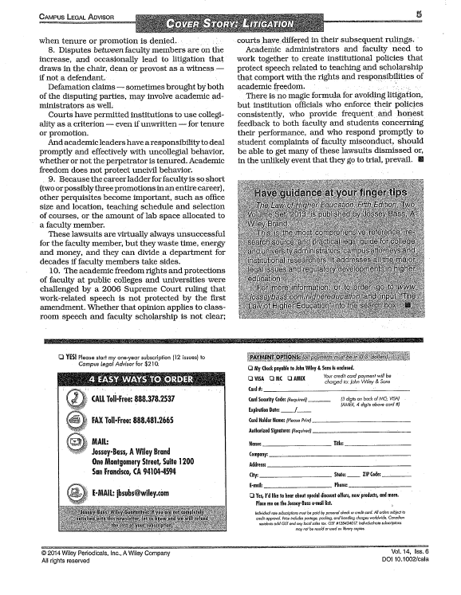
Top legal issues on campus

